Slide 1


CS 6831 Designing Secure Cryptography
Tom Ristenpart

Slide 2

Ciphers part 2: game plan
PRP and PRF security
PRP/PRF switching lemma
Identical-until-bad proofs
Constructing PRFs from PRPs
Feistel construction & Luby-Rackoff
DES, AES
Linear & differential cryptanalysis

Slide 3
PRP/PRF switching lemma
Intuitively: no difference between RF and RP when observing only a few input-output pairs
Notes:
Show basic proof, and point out that it is flawed.
Let Dist be the event that there is no collision among outputs of \rho in game PRF0. Then:
Pr[PRP0^advA => 1] = Pr[PRF^advA => 1 | Dist]

Slide 4
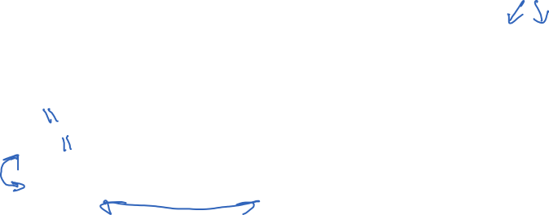
[Bellare, Rogaway 06], similar result [Bellare, Rogaway, Krovetz 98], [Shoup 04]

Slide 5
PRP/PRF switching lemma
As long as q << 2^{n}, can move between considering RP or RF.
Proving PRF and PRP roughly equivalent
Proof shows game-hopping technique
Conservative transitions (that do not change distribution)
Identical-until bad transition
[BR06] paper has lots more details, should read:
https://eprint.iacr.org/2004/331.pdf
We can show that PRF/PRP security implies KR security
Converse is not true
Notes:
Discuss implications?
Corollary 1: Let

Slide 6
Summary so far
TKR
KR
PRP
PRF
loss
Computational security for ciphers. Requires sufficient
key length (exhaustive key search)
block size (when one needs a PRF)
Notes:
k s.t. q/2^k is small
n s.t. q^2 / 2^n is small

Slide 7
PRPs from PRFs
How does one securely build a PRP from a PRF?
Foundational question
Important practical question (e.g.: format-preserving encryption)
Feistel networks
Named after Horst Feistel (worked at IBM in 1970s)
Used in the DES (designed at IBM in 1970s)

Slide 8



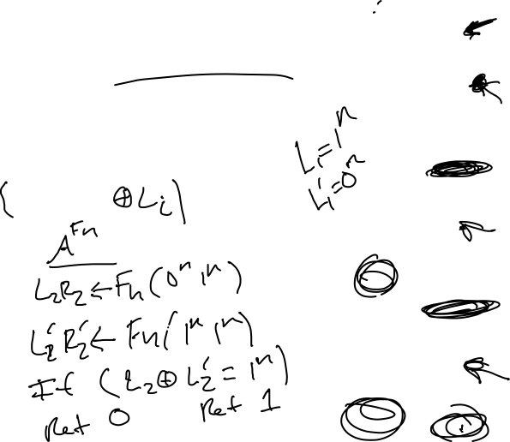
Feistel networks
L0 R0
Let
F_{K}
<1>
Call this the round function. Inputs:
Secret key
round number (encoded as n-bit string)
n-bit string
+
L1 R1
Feistel round is realizes a permutation:
F_{K}
<2>
One-round a secure PRP?
+
L2 R2
Two-rounds a secure PRP?
F_{K}
<3>
Three-rounds a secure PRP?
+
L3 R3

Slide 9
[Luby-Rackoff 1988]

Slide 10
Notes:
LR = L0,R0

Slide 11
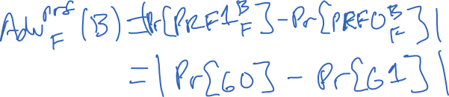

Slide 12




Slide 13
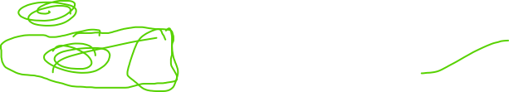

Slide 14
[Luby-Rackoff 1988]
How good are these bounds?
Can we do better when n is small?

Slide 15

Time to shuffle!
1 bit
n-1 bits
Consider a maximally unbalanced
Feistel network.
b
x
This is the same as the so-called
Thorpe shuffle [Morris, Rogaway, Stegers 09]
F_{K}
x
d

Slide 16
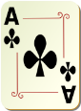
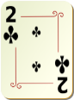
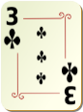
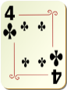
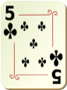
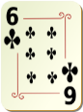
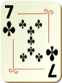
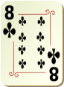
Time to shuffle!
1 bit
n-1 bits
Consider a maximally unbalanced
Feistel network.
b
x
This is the same as the so-called
Thorpe shuffle [Morris, Rogaway, Stegers 09]
F_{K}
x
d
Flip random coin.
Heads put ace down first, tails 5. Say it is heads

Slide 17
Time to shuffle!
1 bit
n-1 bits
Consider a maximally unbalanced
Feistel network.
b
x
This is the same as the so-called
Thorpe shuffle [Morris, Rogaway, Stegers 09]
F_{K}
x
d
Now look at next two in each pile.
Flip a coin, and put them down in appropriate order

Slide 18
Time to shuffle!
1 bit
n-1 bits
Consider a maximally unbalanced
Feistel network.
b
x
This is the same as the so-called
Thorpe shuffle [Morris, Rogaway, Stegers 09]
F_{K}
x
d
Now look at next two in each pile.
Flip a coin, and put them down in appropriate order

Slide 19
Time to shuffle!
1 bit
n-1 bits
Consider a maximally unbalanced
Feistel network.
b
x
This is the same as the so-called
Thorpe shuffle [Morris, Rogaway, Stegers 09]
F_{K}
x
d
0
1
2
3
4
5
6
7
One round of Thorp shuffle
Now think of position in deck
as a numerical value:
5 gets mapped to 2
1 gets mapped to 3
…
This defines a permutation on
3 bits!
Now look at next two in each pile.
Flip a coin, and put them down in appropriate order
0
1
2
3
4
5
6
7

Slide 20
Time to shuffle!
1 bit
n-1 bits
Consider a maximally unbalanced
Feistel network.
b
x
This is the same as the so-called
Thorpe shuffle [Morris, Rogaway, Stegers 09]
F_{K}
x
d
000
001
010
011
100
101
110
111
One round of Thorp shuffle
Now think of position in deck
as a numerical value:
5 gets mapped to 2
1 gets mapped to 3
…
This defines a permutation on
3 bits!
Now look at next two in each pile.
Flip a coin, and put them down in appropriate order
000
001
010
011
100
101
110
111

Slide 21
Time to shuffle!
1 bit
n-1 bits
Consider a maximally unbalanced
Feistel network.
1
00
This is the same as the so-called
Thorpe shuffle [Morris, Rogaway, Stegers 09]
F_{K}
00
x
1
d
000
001
010
011
100
101
110
111
One round of Thorp shuffle
Now think of position in deck
as a numerical value:
5 gets mapped to 2
1 gets mapped to 3
…
This defines a permutation on
3 bits!
Now look at next two in each pile.
Flip a coin, and put them down in appropriate order
000
001
010
011
100
101
110
111

Slide 22
Do all card shuffles define block ciphers?
Sadly no, the shuffle must be oblivious
Idea goes back to Naor
Example:
The traditional “Riffle” shuffle
is not oblivious
Can trace position of a card without
knowing what cards are in other positions,
just knowing random coins related to this card

Slide 23
Balanced Feistel as Shuffle
n bits
n bits
n = 2 bits, N = 2⁴
Split deck into 4 piles of size 4
Take top card from each pile
Place them down in random order
Take next card from each pile
Place them down in random order
…
L
R
F_{K}
R
L’

Slide 24
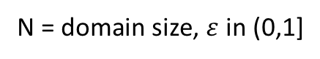

Provable results about shuffles
N = domain size, $ε$ in (0,1]
Approach | Efficiency (# PRF calls) | Provable PRP Security
Balanced Feistel [LR 88] | 3 | q ≈ N^{1/4}
Granboulin-Pornin [GP 07] | O(log³ N) | q ≈ N
Thorp [MRS 09] | O(log N) | q ≈ N^{(1 – ε)}
Thorp [M 09] | O(log³ N) | q ≈ N
Balanced Feistel [HR 10] | O( 6 / ε ) | q ≈ N^{(1 – ε)/2}
Swap-or-Not [HMR 12] | O(log N) | q ≈ (1 - ε)N
Stefanov-Shi [SS 13] | O(N^{1/2}) | q ≈ N
Mix-and-Cut [RY 13] | O(log² N) | q ≈ N
Sometimes-Recurse [MR 13] | Expected O(log N) | q ≈ N
In practice:
FFX is balanced Feistel with heuristically chosen # of rounds
Recent attacks:
[Bellare, Hoang, Tessaro 2016]
[Hoang, Tessaro, Trieu 2018]

Slide 25
Block ciphers built in practice
Block ciphers workhorse of symmetric encryption
Practical ones designed and analyzed via cryptanalysis
Large number of techniques and design principles
Historically: closed door design
Now: ciphers designed through public competition, analysis

Slide 26
Data encryption standard (DES)
Originally called Lucifer
team at IBM
input from NSA
standardized by NIST in 1976
L0 R0
F_{K1}
+
n = 64
k = 56
Number of keys:
72,057,594,037,927,936
L1 R1
F_{K2}
Split 64-bit input into L0,R0 of 32 bits each
Repeat Feistel round 16 times
+
Each round applies function F using
separate round key
L2 R2
…
…

Slide 27
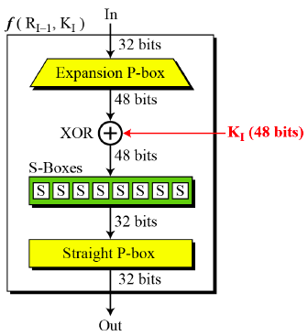
DES round functions
P-box expands 32 bits to 48 bits and permutes
S-boxes: 6-bit to 4-bit lookup tables
XOR in round key
16 48-bit round keys derived via key schedule from 56 bit key deterministically
How S-boxes chosen? Why particular permutations?

Slide 28
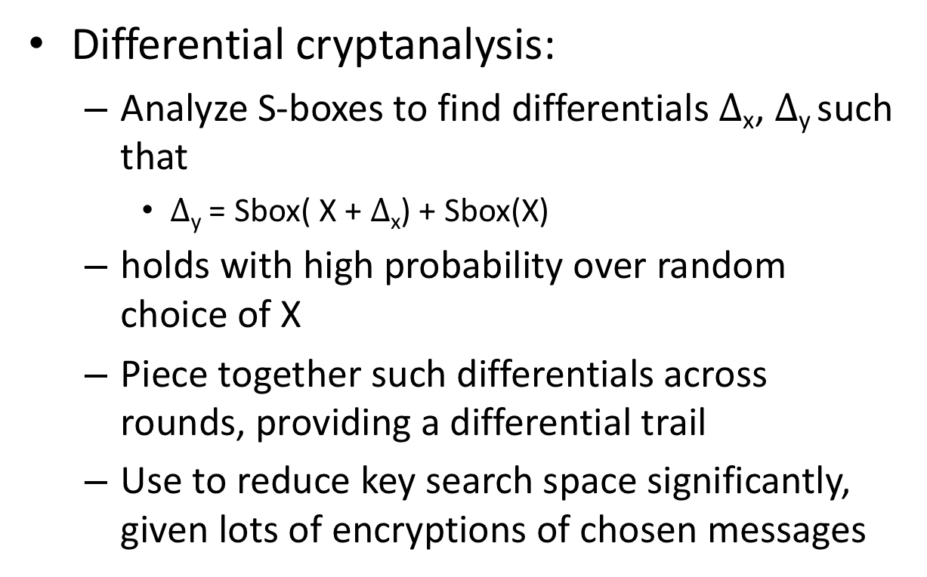
Differential cryptanalysis
Differential cryptanalysis:
Analyze S-boxes to find differentials $∆$_{x}, $∆$_{y} such that
$∆$_{y} = Sbox( X + $∆$_{x}) + Sbox(X)
holds with high probability over random choice of X
Piece together such differentials across rounds, providing a differential trail
Use to reduce key search space significantly, given lots of encryptions of chosen messages
[Biham, Shamir 1992]

Slide 29
Linear cryptanalysis
Linear cryptanalysis:
Approximate S-box behavior by linear functions, e.g.,:
X1 + X2 + X6 = Y1 + Y2 + Y4
S-boxes exhibit some biases, meaning some linear functions are satisfied with higher probability (over uniform inputs)
Can carefully “pile up” linear approximations across multiple DES rounds
Use linear approximations to efficiently narrow down search for key, given lots of encryptions of uniform messages
[Matsui 1993]
http://www.cs.bc.edu/~straubin/crypto2017/heys.pdf

Slide 30
Best attacks against DES
Attack | Attack type | Complexity | Year
Biham, Shamir | Chosen plaintexts, recovers key | 2⁴⁷ plaintext, ciphertext pairs | 1992
Matsui | Known plaintexts, recovers key | 2⁴⁷ plaintext, ciphertext pairs | 1993
DESCHALL | Brute-force attack | 2^{56/4} DES computations 41 days | 1997
EFF Deepcrack | Brute-force attack | ~4.5 days | 1998
Deepcrack + DESCHALL | Brute-force attack | 22 hours | 1999
DES is still used in some places
3DES (use DES 3 times in a row with more keys) expands
keyspace and still used widely in practice

Slide 31
Advanced Encryption Standard (AES)
Rijndael (Rijmen and Daemen)
M
n = 128
k = 128, 192, 256
Permute
Number of keys for k=128:
340,282,366,920,938,463,463,374,607,431,768,211,456
S1
+
K1
Substitution-permutation design.
For k=128 uses 10 rounds of:
Permute
1) Permute:
SubBytes (non-linear S-boxes)
ShiftRows + MixCols (invertible linear transform)
S2
+
K2
Permute
2) XOR in a round key derived from K
(Actually last round skips MixCols)
…

Slide 32
Best attacks against AES
Brute-force attack (try all keys): worst case time about 2¹²⁸
Attack | Attack type | Complexity | Year
Bogdanov, Khovratovich, Rechberger | chosen ciphertext, recovers key | 2^{126.1} time + some data overheads | 2011
No direct attacks of practical interest known
Side-channel attacks do exist, need to implement carefully

Slide 36
Towards message privacy definitions
Notes:
Multiple queries, security fails trivially, so restrict to a single query for now. Can do in game or by limiting types of adversaries considered
For any single-query otIND adversaries, can show that Adv(A) = 0
Prove that

Slide 37
OTP otIND security

Slide 38
Shannon’s theorem

